Slide 2
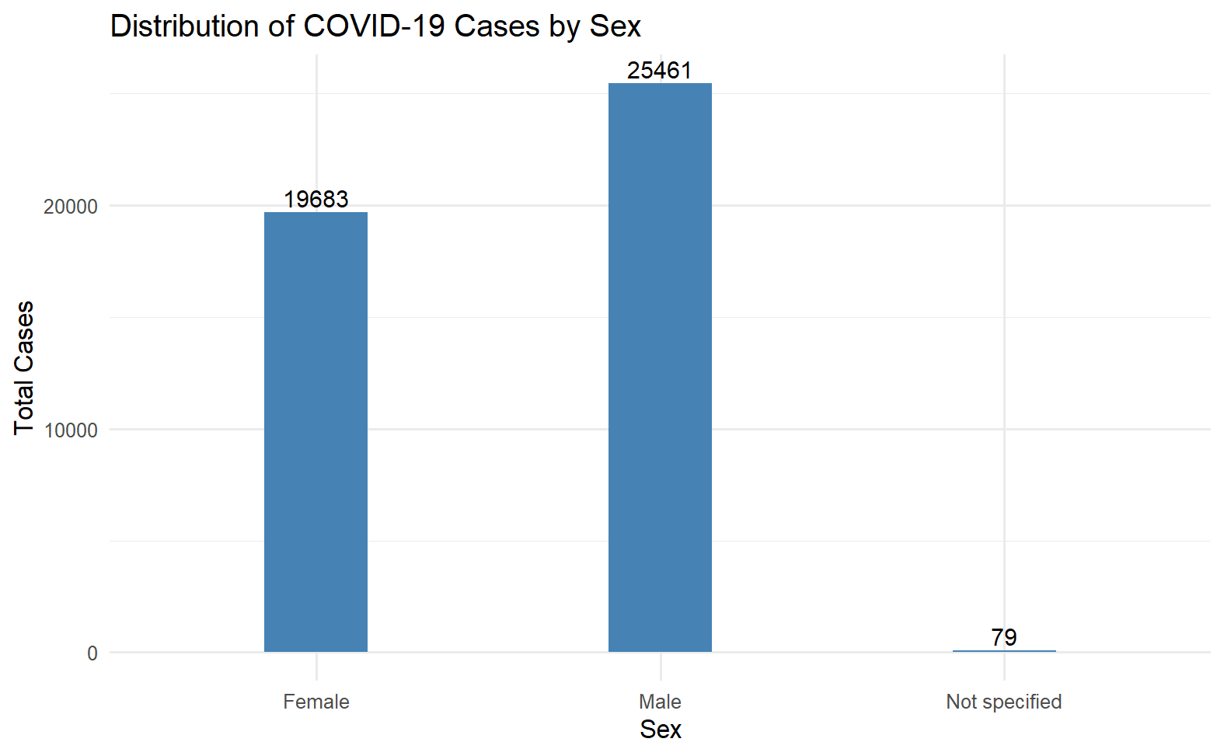

Slide 3
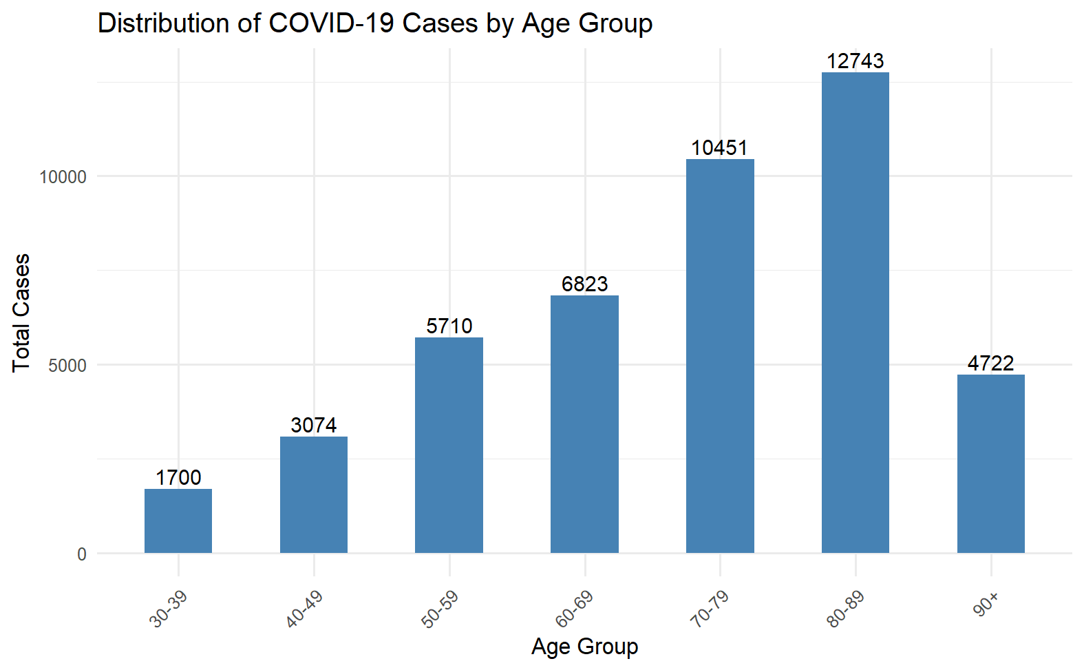

Slide 4
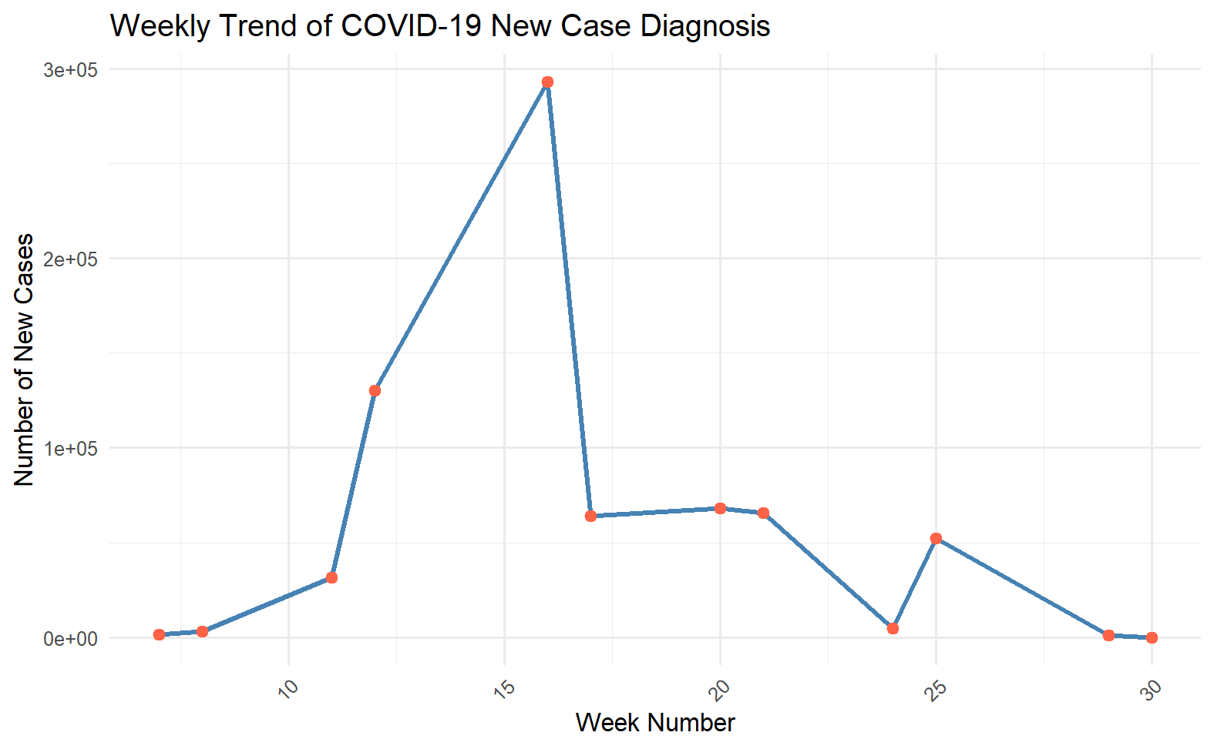
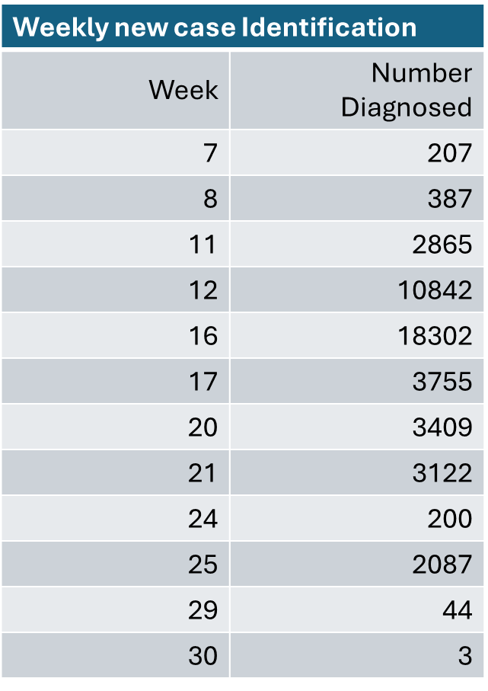

Slide 5
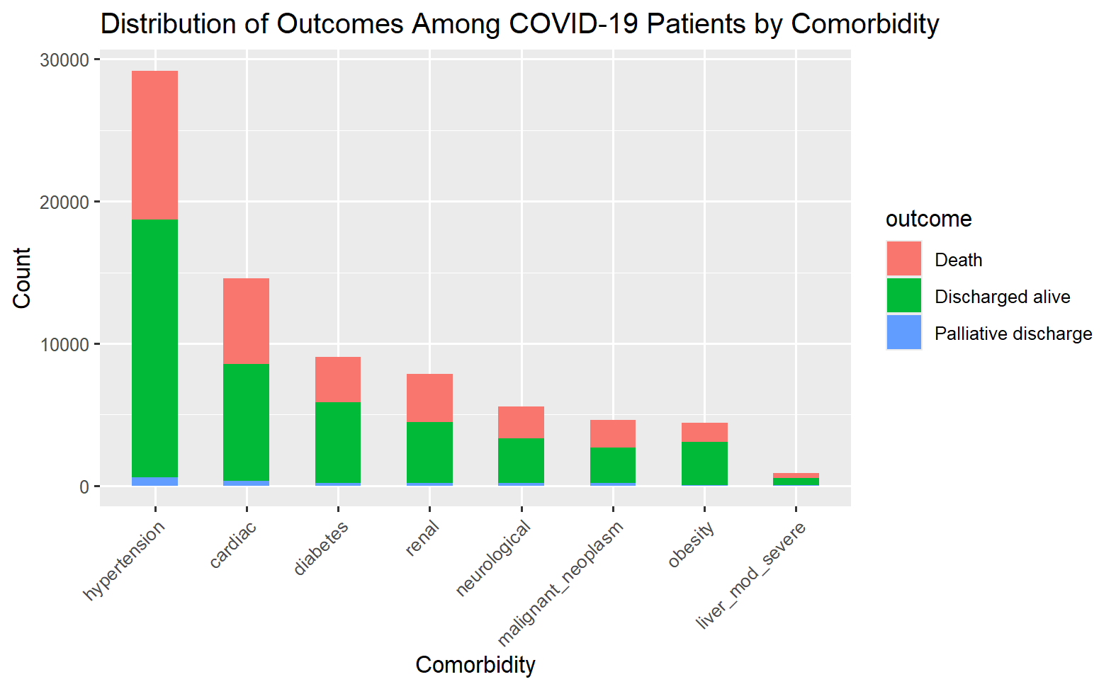

Slide 6
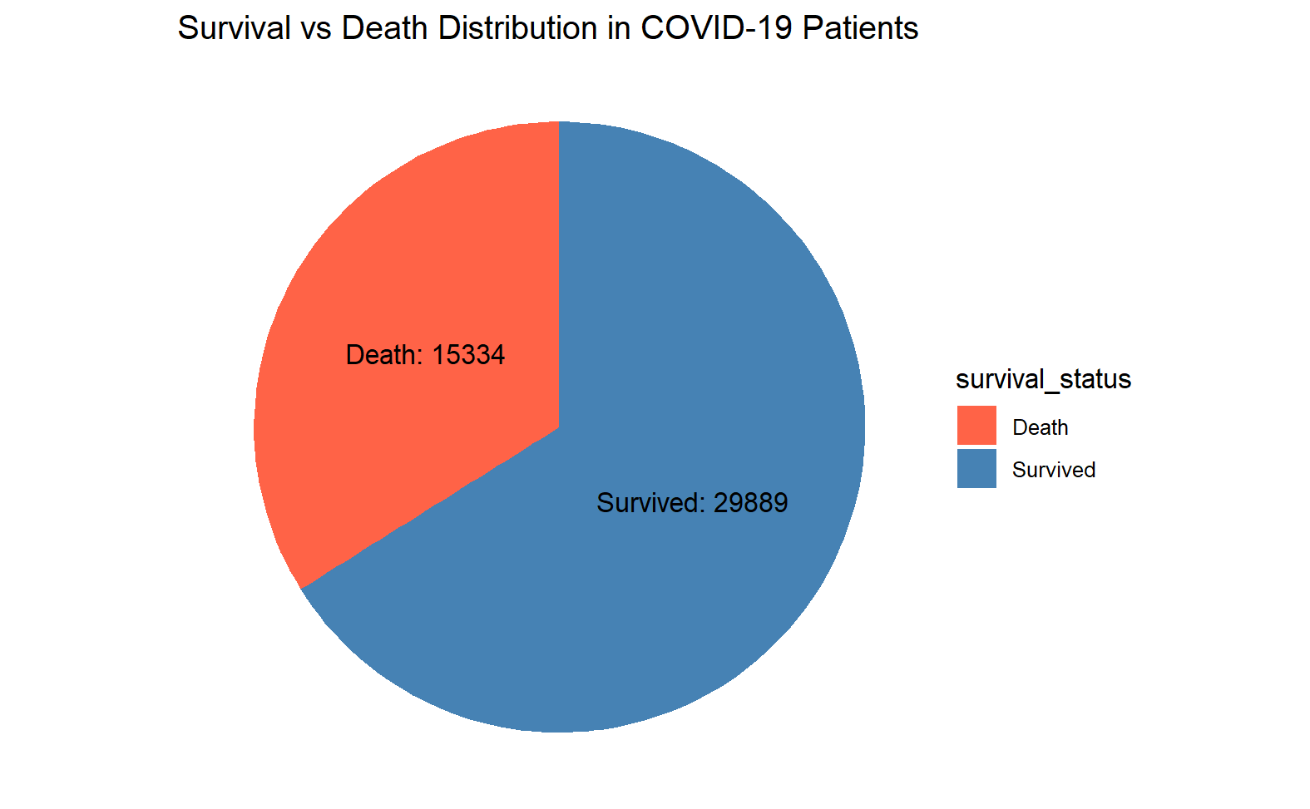

Slide 7
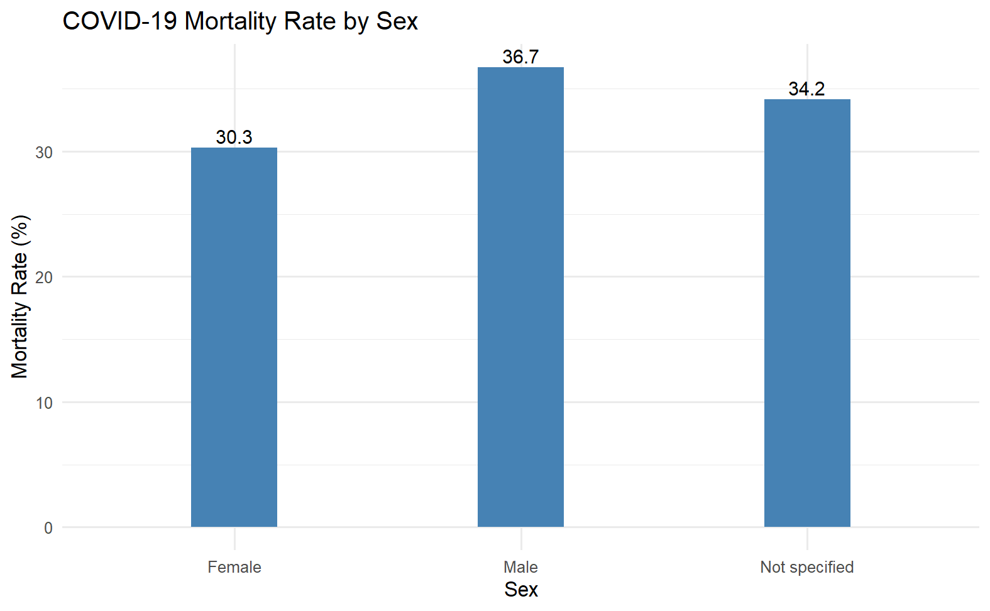

Slide 8
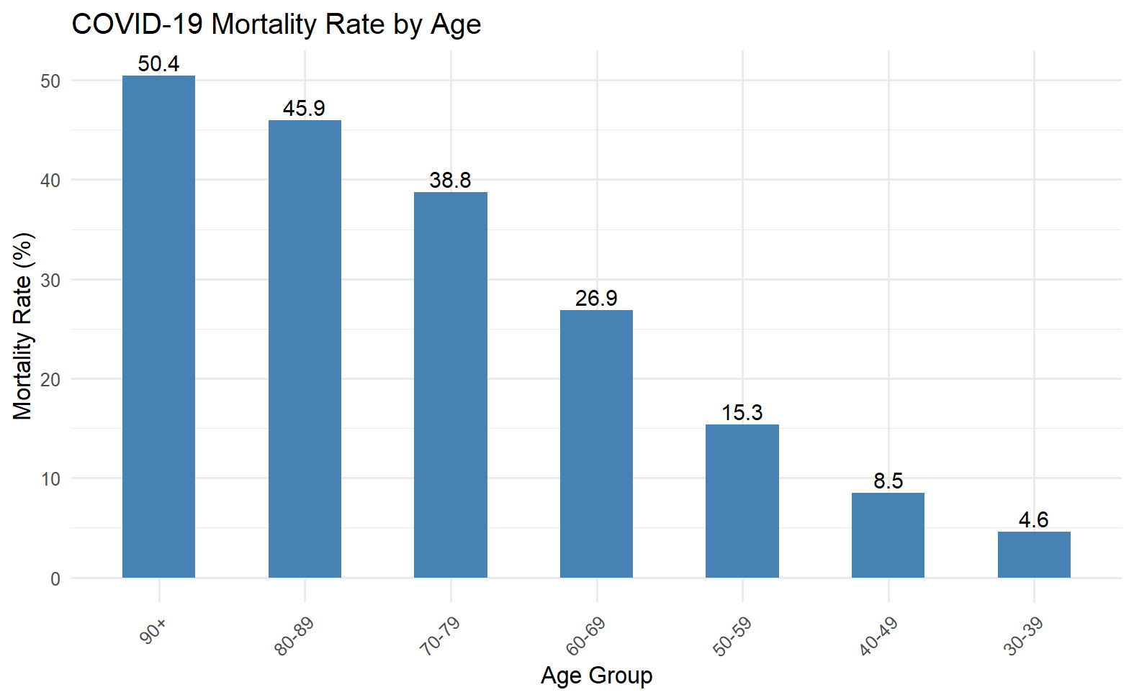

Slide 9
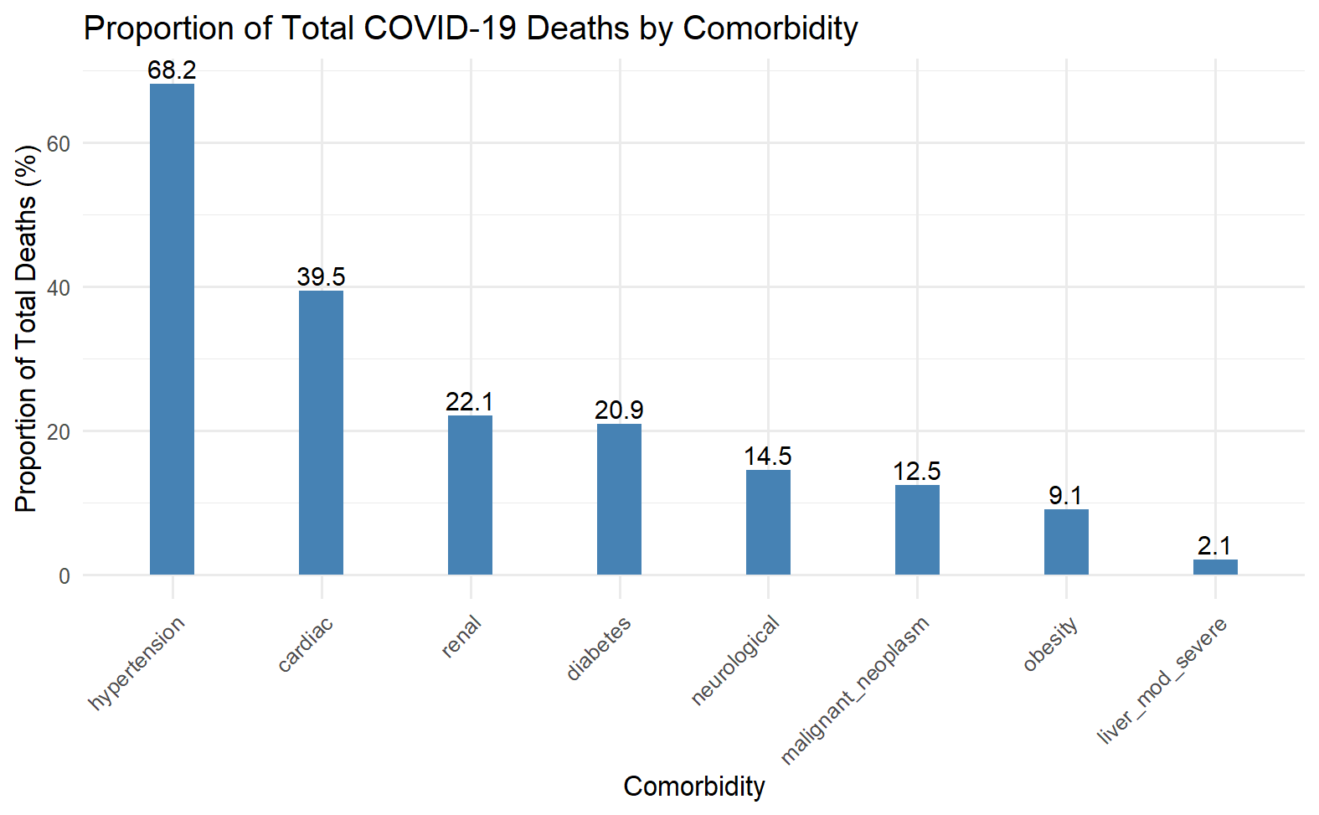

Slide 10
Weekly new case Identification
Week | Number Diagnosed
7 | 207
8 | 387
11 | 2865
12 | 10842
16 | 18302
17 | 3755
20 | 3409
21 | 3122
24 | 200
25 | 2087
29 | 44
30 | 3

